Slide 1
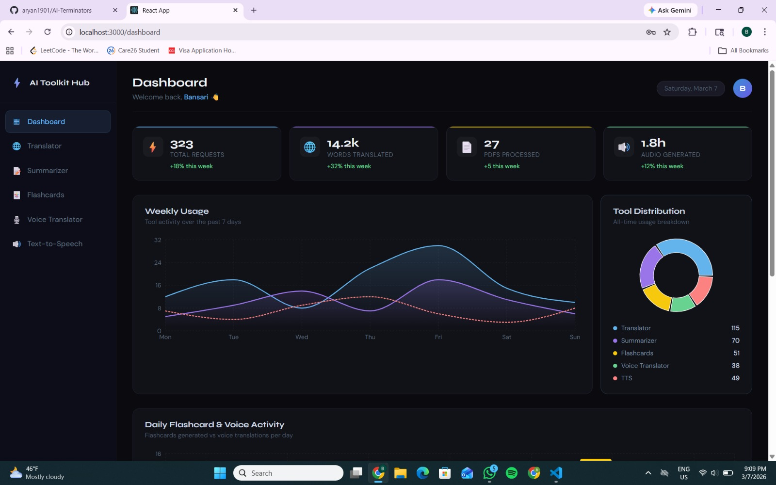
AI Toolkit Hub
Sprint 1 Presentation
A unified platform for translation, summarization, flashcards, voice translation, and text-to-speech
Team:
Aryan Patel(U01999176)
Bansari Shah(U01983468)
Laxmi Prasanna(U01950459)
Pratham Patel(U02002338)
Vivek Pitroda(U01992349)

Slide 2
Agenda
Sprint scope and deliverables
Project overview
Team roles and working agreement
Technology stack and algorithms
System diagrams
Frontend and backend implementation
Sprint metrics and burndown
Completed work and demo
Language translation
Text summarization
PDF to flashcards
Live voice translation
Text to speech
Key Features

Slide 3
Problem Statement
Target users, pain points, and solution hypothesis
Who
What
Students, educators, professionals, and multilingual users working with long texts, PDFs, and cross-language communication
Time wasted switching between multiple tools for translation, summarizing, studying, and voice translation
Why Current Solutions Fail
Fragmented experience across 3-5 apps
Limited history and export options
Voice translation doesn't pair with text records
Hypothesis
We believe that building a single AI Toolkit Hub for students and multilingual professionals will reduce time spent switching tools and improve comprehension by combining language and study workflows into one unified platform.

Slide 4
Team Roles & Responsibilities
Role ownership across product, frontend, backend, AI/ML, and QA/DevOps
Product Owner
Requirements, user stories, backlog priority, sprint planning
Aryan Patel
Frontend Lead
React.js UI, Tailwind CSS, API integration, flashcard UI
Bansari Shah
Backend Lead
Node.js APIs, JWT authentication, database, endpoints
Pratham Patel
AI/ML Lead
AI API integration, prompt design, PDF to flashcard logic
Vivek Pitroda
QA/DevOps
Testing, GitHub workflow, deployment, documentation
Lakshmi Prasanna

Slide 5
Team Working Agreement
Communication norms, meetings, work expectations, and accountability
Communication
Meetings
Google Meet, WhatsApp, Notion
24-hour response time
Early notification of unavailability
Saturday 4-5pm (Virtual)
Monday 9-10pm (Virtual)
Wednesday 4:30-5:30pm (In-person)
Work Expectations
Accountability & Quality
Complete assigned tasks by deadline
Reach out early if blocked
Fair workload distribution
Supportive accountability
Open communication on missed deadlines
Review work before submission

Slide 6
User Persona-1
Name: Liam Chen Age: 26 Occupation: Language Learner & Content Creator Tech Skill Level: Intermediate
Background Liam is learning multiple languages and creates educational content online. He frequently uses speech and translation tools for language practice and accessibility.
Goals
Practice speaking and translating languages in real time
Generate audio versions of text content
Improve language comprehension through translation tools
Frustrations
Lack of real-time translation during conversations
Difficulty converting text to speech for accessibility
Switching between different apps for language learning
How AI Toolkit Helps
Live Voice Translator enables real-time translation
Text-to-Speech converts written content into audio
Translator supports 50+ languages for learning
Language Learner / Accessibility User

Slide 7
User Persona-2
Name: Daniel Carter Age: 32 Occupation: Marketing Manager Tech Skill Level: Advanced
Background Daniel works in a global company and regularly communicates with international clients. He needs quick access to translation and content summarization tools to save time during work.
Goals
Translate emails and documents quickly
Summarize long reports into key insights
Convert written content into audio for multitasking
Frustrations
Spending too much time reading long reports
Difficulty communicating with clients in other languages
Using multiple separate AI tools
How AI Toolkit Helps
Language Translator enables fast communication
Text Summarizer extracts key insights from reports
Text-to-Speech allows listening to documents while working
Busy Professional

Slide 8
User Persona-3
Name: Maria Gonzalez Age: 21 Occupation: University Student (International Student) Tech Skill Level: Intermediate
Background Maria recently moved to the U.S. for university. English is not her first language, so she often struggles with understanding academic articles and lecture materials.
Goals
Translate academic material quickly
Summarize long articles for studying
Convert lecture PDFs into flashcards for exam preparation
Frustrations
Reading long academic papers in English
Manually creating study notes and flashcards
Switching between multiple tools for studying
How AI Toolkit Helps
Language Translator helps translate complex content
Text Summarizer condenses long articles
PDF-to-Flashcards tool automatically creates study material
International Student

Slide 9
Technologies
Frontend, backend, AI services, and database stack
Frontend
Backend
React.js
Tailwind CSS
Axios
react-card-flip
Framer Motion
Node.js + Express.js
Multer (file uploads)
pdf-parse
JWT + bcrypt
AI Services
Database
MyMemory Translation API
Hugging Face (BART, FLAN-T5)
Web Speech API
MongoDB

Slide 10
MINIMAL VIABLE PRODUCT (MVP)
The Minimum Viable Product (MVP) for our project is a fully functional end-to-end web application that allows users to securely create an account, log in, and interact with a personalized dashboard using a full-stack architecture.
Core Features Included in the MVP:-
1. User Registration
2. User Login / Authentication
3. Dashboard Interface
4. Backend API Integration
5. Database Connectivity
6. API Testing

Slide 11
Algorithms & Processing Logic
How each feature is powered under the hood
Text Translation
Input validation, language mapping, history logging
MyMemory API + rule-based handling
Text Summarization
Length control, formatting logic, response cleanup
facebook/bart-large-cnn
PDF to Flashcards
Text extraction, chunking, Q&A generation, JSON formatting
google/flan-t5-large + pdf-parse
Live Voice Translation
Real-time transcription, API chaining, error fallback
SpeechRecognition → Translation → Synthesis
Text-to-Speech
Voice selection, pitch/rate control, playback management
Web Speech API
Authentication
Password hashing, token generation, middleware verification
JWT + bcrypt

Slide 12
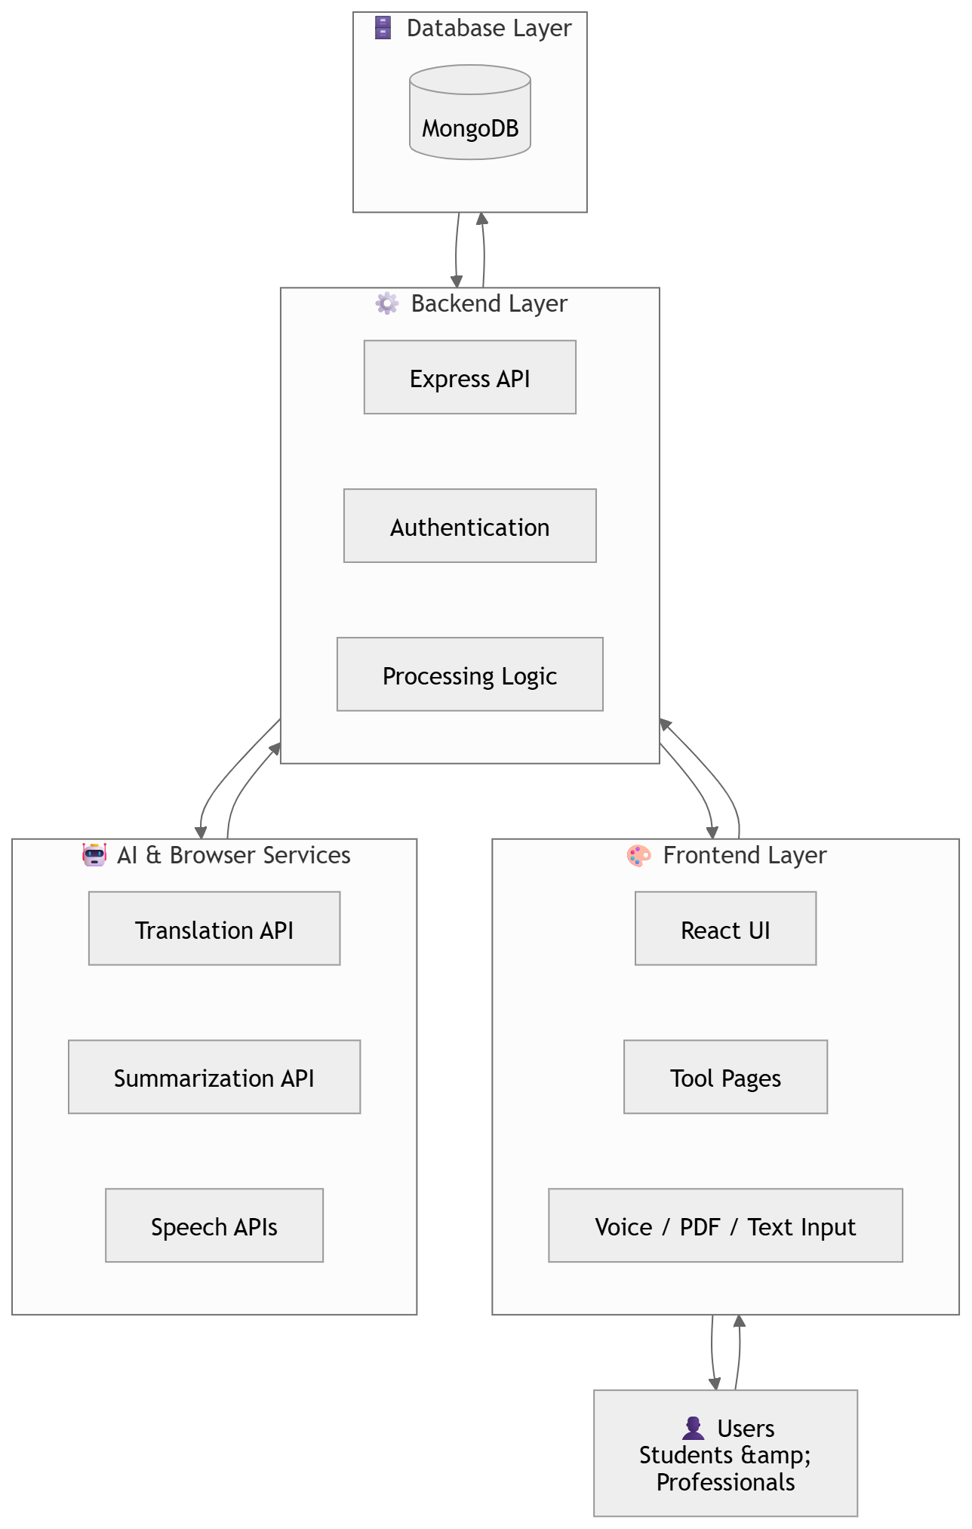
System Architecture Diagram
Updated architecture diagram provided by the team

Slide 13
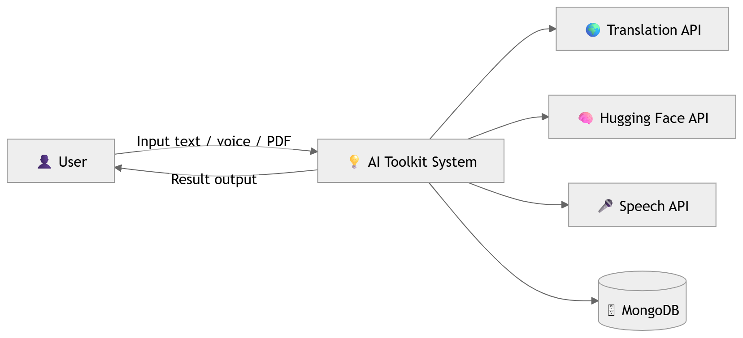
Context Diagram
Updated high-level system context with user and service interactions

Slide 14
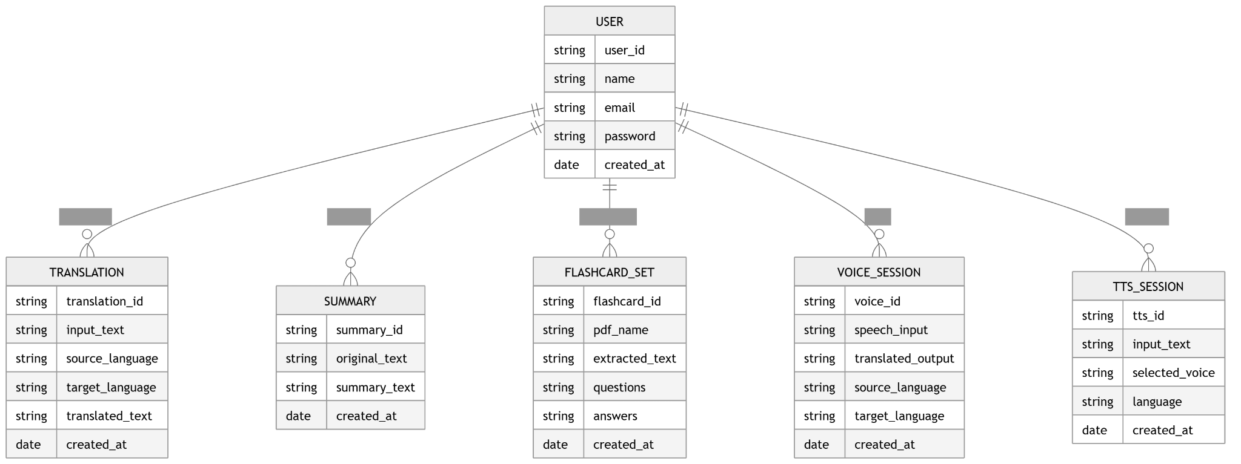
ER Diagram
Updated database design and entity relationships

Slide 15
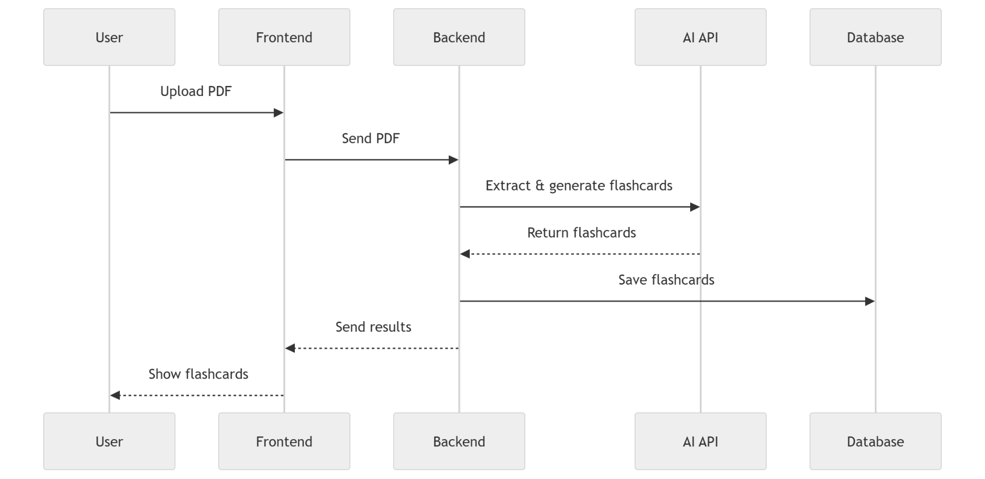
Sequence Diagram
Updated interaction flow for the PDF-to-flashcards feature

Slide 16
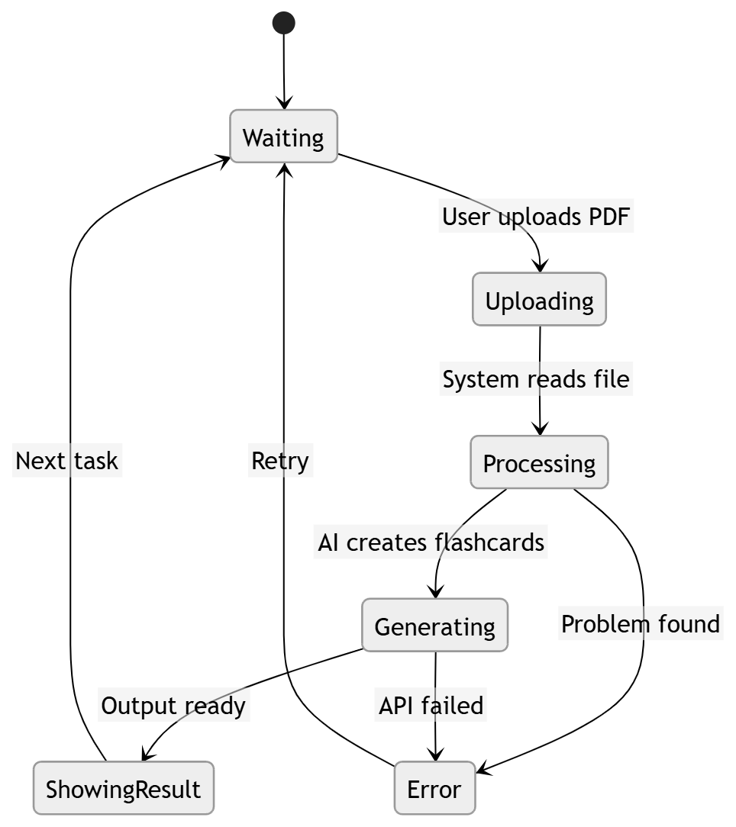
State Diagram
Updated state transitions for flashcard generation

Slide 17
PRODUCT BACKLOG
ID | User Story | Priority
US-01 | User can create a new account (registration). | High
US-02 | User can log into the system securely. | High
US-03 | System authenticates users using JWT tokens | High
US-04 | User can access a personalized dashboard. | High
US-05 | System stores user data securely in MongoDB. | High

Slide 18
PRODUCT BACKLOG
ID | User Story | Priority
US-06 | Backend provides REST APIs for frontend communication. | Medium
US-07 | APIs are tested using Postman for reliability. | Medium
US-08 | Dashboard displays user information dynamically. | Medium
US-09 | Protected routes prevent unauthorized access. | High
US-10 | Application UI is responsive and user-friendly. | Medium

Slide 19
ACCEPTANCE CRITERIA & USER STORIES
Story 1 – User Registration
Story 2 – User Login
Story 3 – User Dashboard
User Story: As a user, I want to create an account so that I can access the system.
Acceptance Criteria:
User can enter name, email, and password
System validates all required input fields
Password is encrypted before storing in the database
User data is successfully saved in MongoDB
System displays confirmation message after registration
User Story: As a registered user, I want to log into the system securely.
Acceptance Criteria:
User enters registered email and password
System verifies credentials from the database
JWT authentication token is generated upon successful login
Invalid credentials display an error message
User is redirected to the dashboard after login
User Story: As a logged-in user, I want to access a dashboard to view my account information.
Acceptance Criteria:
Only authenticated users can access the dashboard
User data is retrieved from the MongoDB database
Dashboard loads successfully after login
Unauthorized users are prevented from accessing protected routes

Slide 20
Test Cases
Test ID | Test Scenario | Test Action | Expected Result
TC-01 | User Registration (Valid Input) | Enter valid name, email, and password | Account created and data stored in MongoDB
TC-02 | User Registration (Missing Fields) | Submit form with empty fields | Validation error message displayed
TC-03 | User Login (Valid Credentials) | Enter correct email and password | User successfully logged in and redirected to dashboard
TC-04 | User Login (Invalid Password) | Enter wrong password | System displays "Invalid credentials" error

Slide 21
Test Cases
Test ID | Test Scenario | Test Action | Expected Result
TC-05 | Unauthorized Dashboard Access | Attempt to access dashboard without login | Access denied and redirected to login page
TC-06 | Registration API Test (Postman) | Send POST request to registration API | User data stored successfully in database
TC-07 | Login API Test (Postman) | Send POST request to login API | JWT authentication token returned

Slide 22
STROIES COMPLETED
User registration functionality implemented
Secure login system with JWT authentication
MongoDB database connection established
User data successfully stored in database
Basic dashboard interface created
Frontend connected to backend APIs
API testing performed using Postman

Slide 23
STROIES NOT COMPLETED
Application deployment to cloud platform
Mobile responsiveness optimization
UI/UX improvements for dashboard
Advanced dashboard analytics features

Slide 24
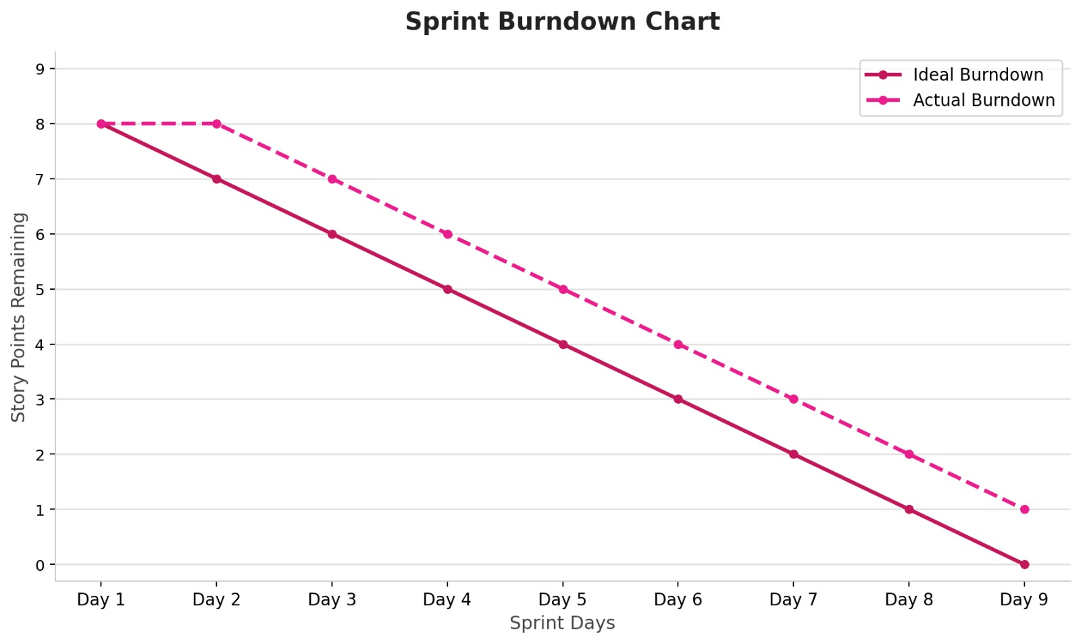
Metrices
Sprint Burndown Chart

Slide 25
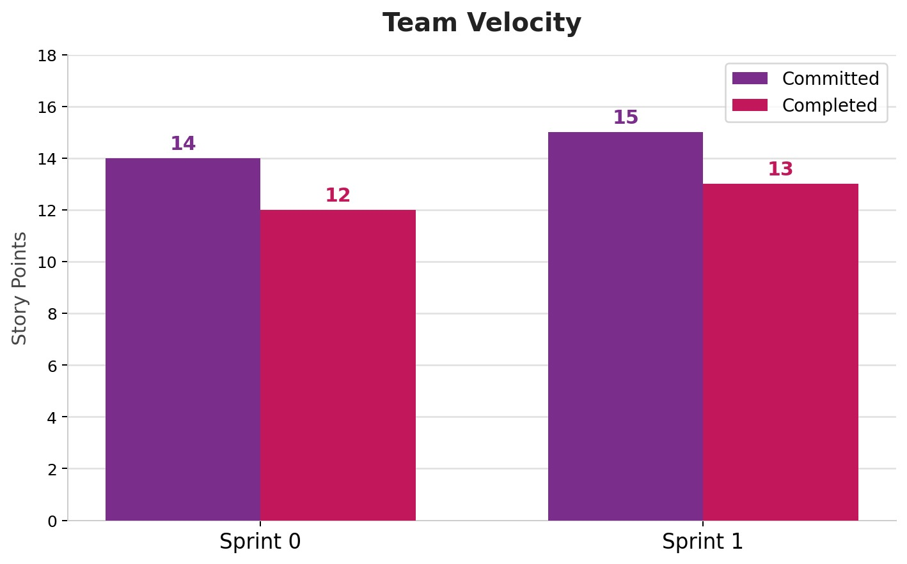
Metrices
Team velocity
&
Committed v/s completed work

Slide 26
Sprint Retrospective
What Went Well
What Didn’t Go Well
The authentication system was implemented successfully
Frontend and backend integration worked correctly.
MongoDB database connection was established.
API testing using Postman helped verify functionality.
Team members collaborated effectively during the sprint.
Some tasks required more time than originally estimated.
Minor bugs occurred during API integration.
UI improvements were delayed due to focus on backend features.
One user story was not completed during the sprint.

Slide 27
Sprint Retrospective
Improve sprint planning and task estimation.
Allocate additional time for testing and debugging.
Complete the remaining user story.
Improve the dashboard UI and user experience.
Maintain regular team communication and progress tracking.
Improvements for Next Sprint

Slide 28
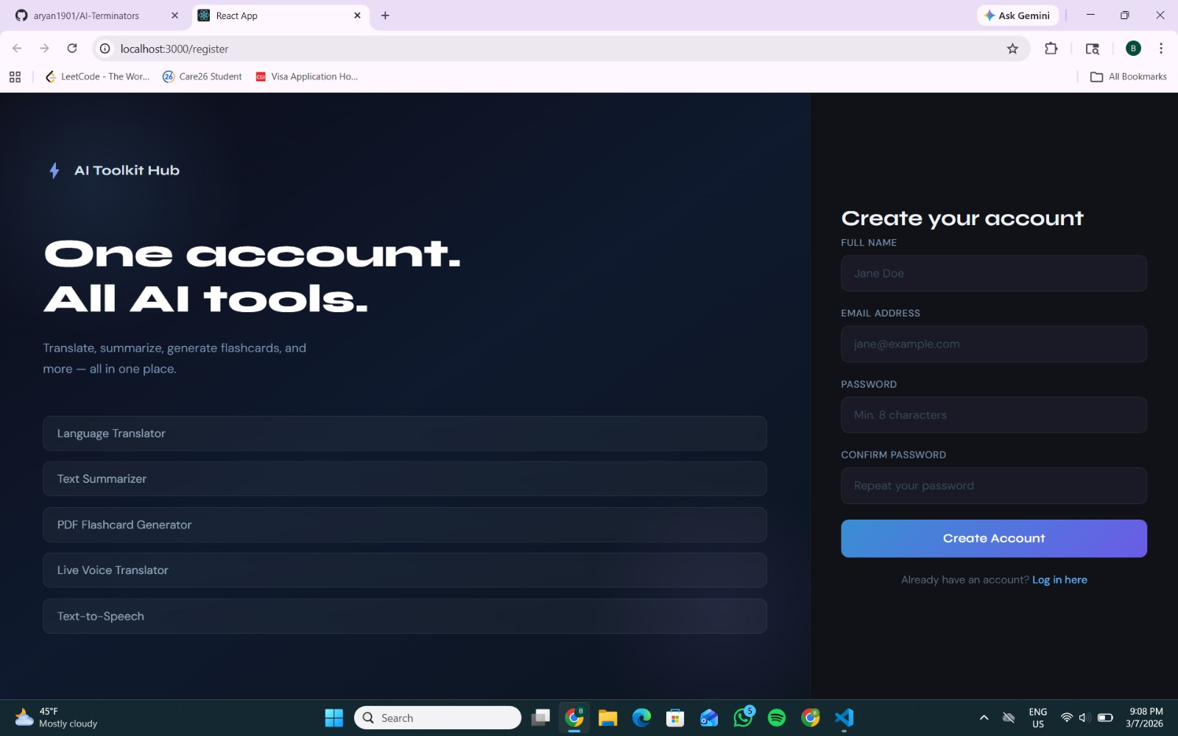
Frontend • Registration
Authentication entry point with modern React UI

Slide 29
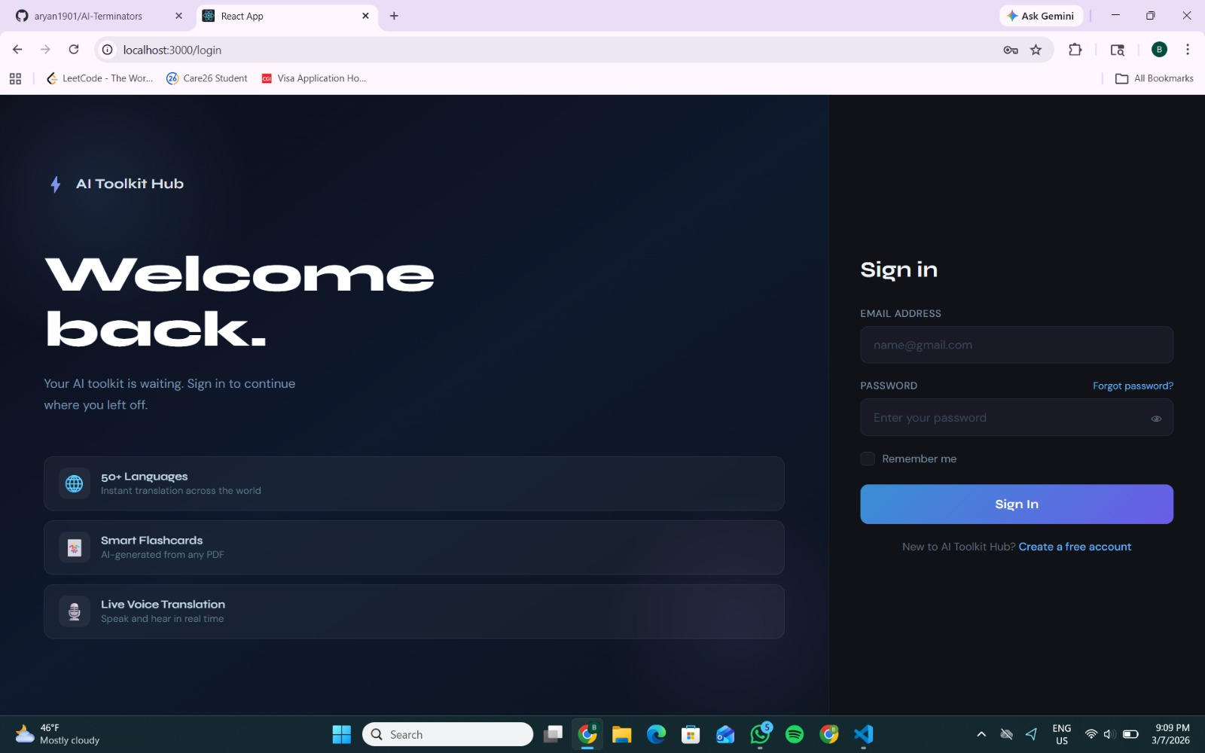
Frontend • Login
Authentication entry point with modern React UI

Slide 30
Frontend • Dashboard
Usage metrics and tool navigation

Slide 31
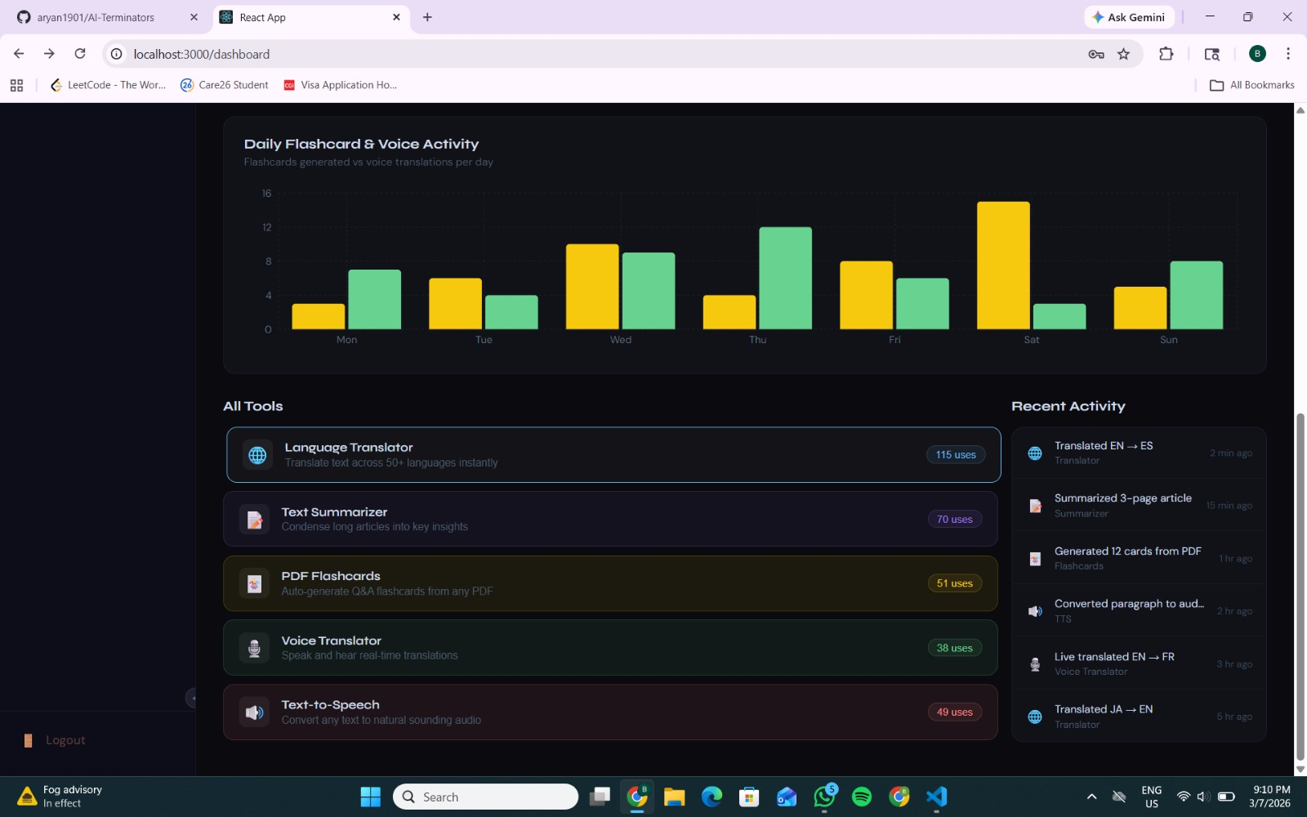
Frontend • Graphs & Activity Panels
Tool distribution, activity, and dashboard insights

Slide 32
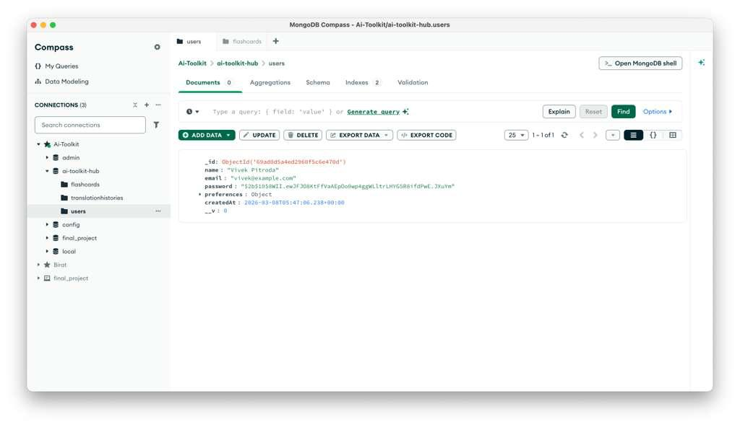
MongoDB Collection

Slide 33
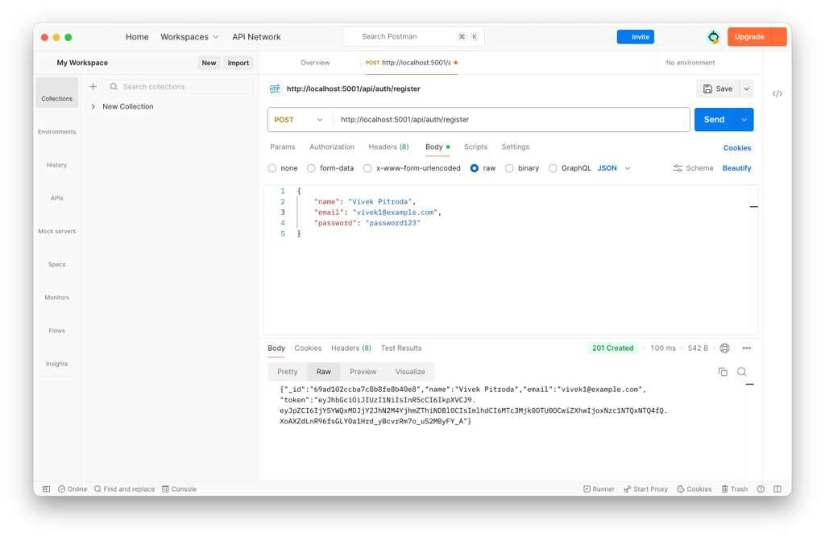
API Testing
Postman validation of register/login endpoints and API responses

Slide 34
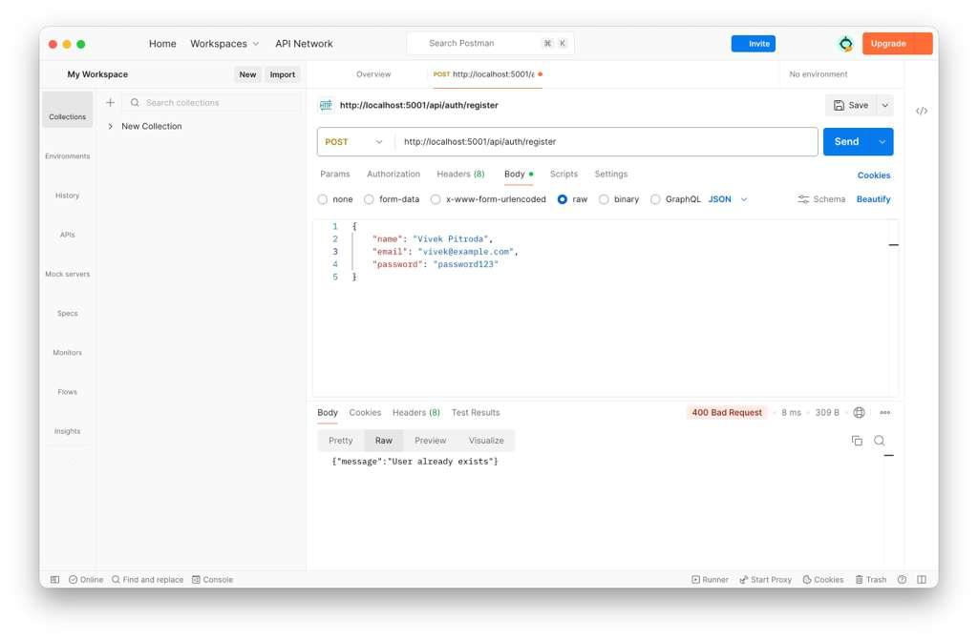
API Testing
Postman validation of register/login endpoints and API responses

Slide 35
Sprint 1 Metrics
Execution summary for the current sprint
Committed tasks: 14
Completed tasks: 12
Completed/Committed ratio: 86%
Velocity: 12 story points
Improve flashcard generation quality
Expand voice translation workflows
Refine UI polish and responsiveness
Add more feature-level analytics
Sprint 2 Focus

Slide 36
Project Demo
Recommended flow for the live walkthrough
Create a user account
Log in successfully
Show dashboard metrics
Open translator/summarizer
Demonstrate PDF flashcards
Evidence of full-stack implementation
Clear modular architecture
API integration and database persistence
Agile sprint tracking
Professor Takeaways

Slide 37

Thank you!

